Slide 1
Internet of things and security
Adrianna Holden-Gouveia

Slide 2
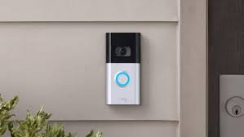
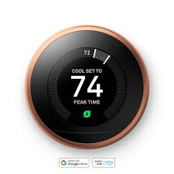
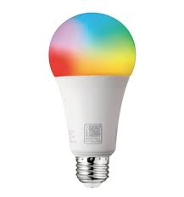
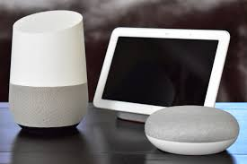
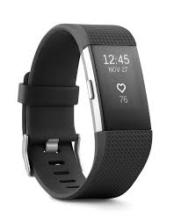
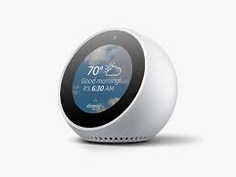
What is the Internet of things (iot)
The Internet of Things (IoT) refers to the network of interconnected devices and objects embedded with sensors, software, and internet access
Some examples of IoT devices you may have heard of are:
Ring doorbells
Nest Thermostats
Amazon Echo
Garman/FitBit style wearables
Google Home
Smart Lights/Light switches/Outlets

Slide 3
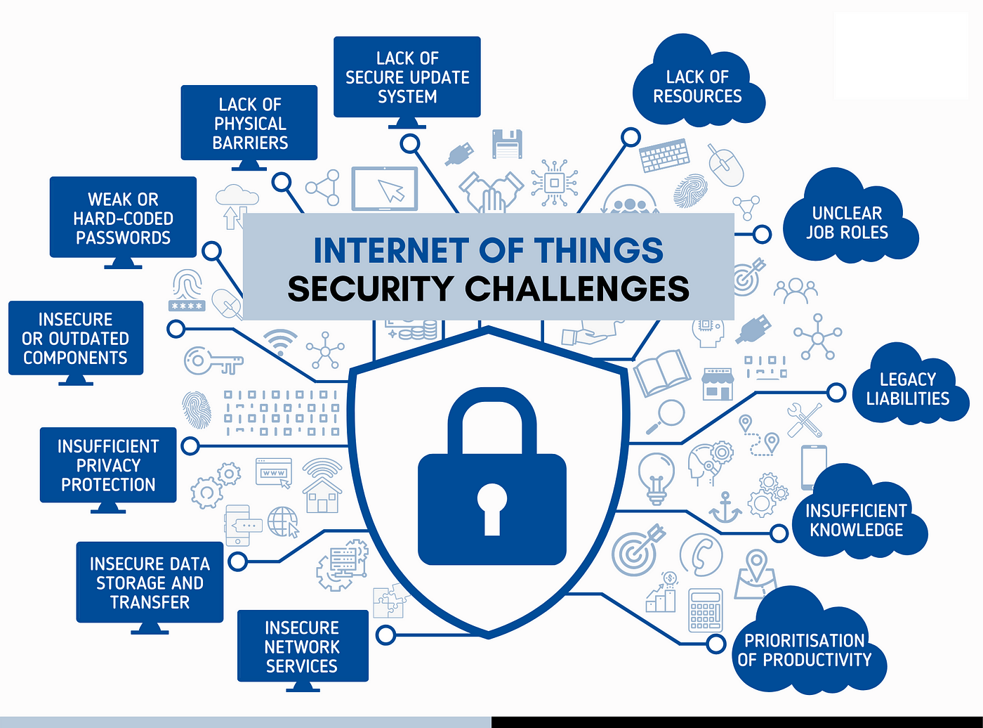
Why security is needed for IOt
Almost every commercial device sends your data to the company that created the device
Almost every device also sends your data, and sells your data to others
Many devices I researched have back doors installed in such a way they can't be fixed so that the company can access it as soon as it's connected and you can't stop them.
If you don't know where your data is, what's being collected, or who owns it you are at a disadvantage
Most devices don't focus on security because it's expensive and would hinder the secondary market of selling data
Most companies will offset the hardware cost of the device by selling the data to others
https://miro.medium.com/v2/resize:fit:1400/1*QkVjbNXltUXYBeBnYhEaSg.png

Slide 4
My Sabbatical Projects
PoE (Power over Ethernet)
Logitech Media Server (LMS)
IoT Smart Home Kit
Air Quality Sensor
Portable C02 Monitor
Octoprint (3D print monitoring)
Magic Mirror
Home Server
Virtualization for your Server
CCTV (Video cameras)
Home Assistant

Slide 5

How each writeup is structured
Each write up has a section for ratings, covers difficulty, cost, and skills needed
If there is a skill I have OER (Open Educational Resources) for, that is linked as well
Each section has a writeup with descriptions, troubleshooting, suggestions, and how I completed the project
At the end there is a table with a cost breakdown including links to the supplies I bought. Or would buy if I needed to restock

Slide 6
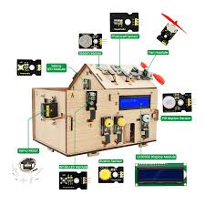
IOT smart home kit
This project is a kit with everything you need to try several types of IoT devices
This kit is designed as a tutorial, if you have little or no experience you can still use this kit
There is a complete walkthrough of how to put together the kit, download and install the software needed, and experiments to try to build your confidence
If you can plug in a cord and install a program on your computer you can build and play with this kit

Slide 7
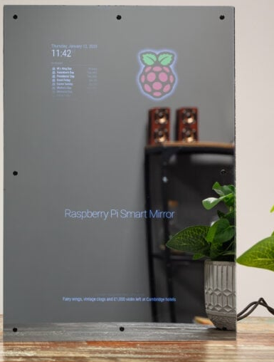
Magic mirror
This project has a very robust community
There are forums, videos, and a whole bunch of people working on this project, and working to make it accessible to everyone
This project can be as simple or complex as you want, and you can add more as you become more comfortable
You could use an old tablet for this project if you wanted to, or a Raspberry Pi
This project has the potential to be totally customizable to what you want it to be, while staying accessible to almost anyone, children under 12 should have parental supervision for the glue and frame. Getting glue out of hair is not fun.
https://www.raspberrypi.com/tutorials/how-to-build-a-super-slim-smart-mirror/

Slide 8
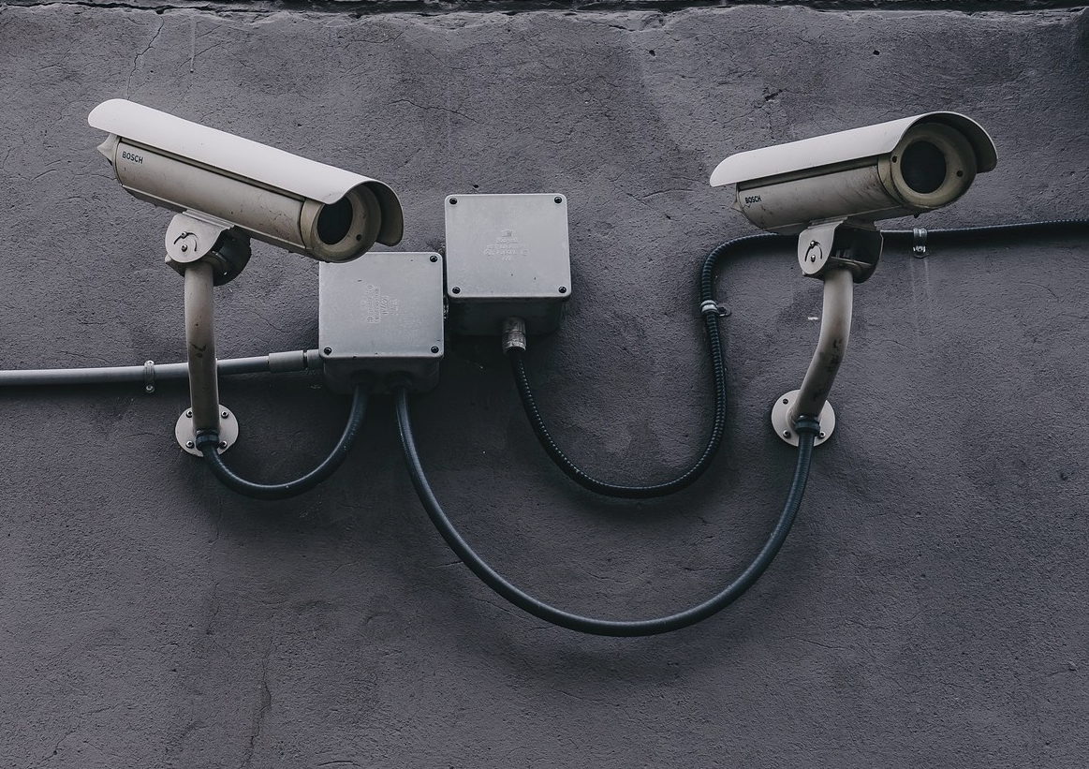
cctv
Adding secure cameras to your home can be very straightforward, and there are 2 ways to set up these cameras for monitoring
You can either set up the first system, ZoneMinder, on any old computer or start working on a home server.
Securing cameras can be as simple as making sure to use ones that aren't vulnerable by default, and to practice good security hygiene such as good passwords.
The safest way to use cameras in your home is to set them up on their own network. Most modern routers can do a second Wi-Fi. Or you could setup a PoE system (one of my other projects)

Slide 9
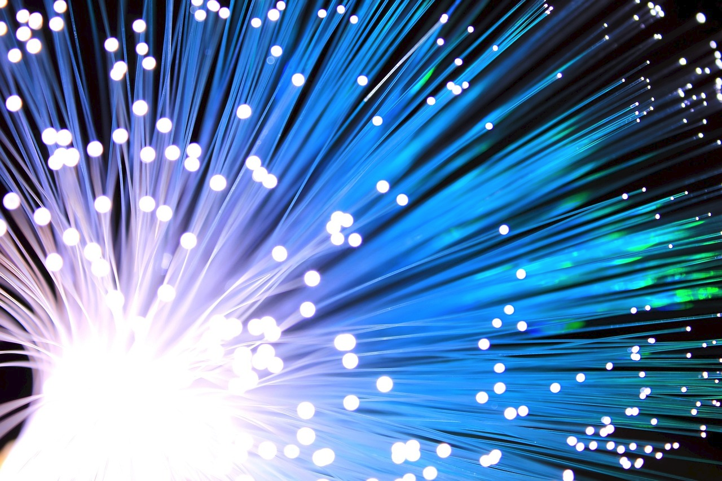
Power over ethernet (poe)
This sounds scarier than it is. Really.
You can either learn to make your own cables and save some money, or buy them.
Then you pick a special kind of technology to plug them into.
Yes really, if you can plug in a cable and hit a "buy now" button you can do this
You can also make it even better by running the cables in your home either through walls or protected on the floors.
Cameras can also be used outside if you buy the right ones and then you have the ability to watch birds and animals. If you aren't old enough to be hit by the birdwatching bug. It's coming. No, really.

Slide 10
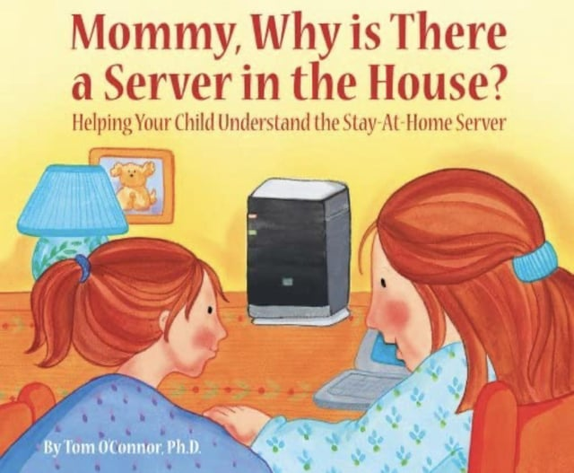
Home server and virtualization
Having a home server setup is a great way to experiment with lots of different kinds of options for security and your IoT devices
If you have your own server you can route your information through there instead of through other people's, and then your information can stay in your home instead of available for others
Setting up a virtual environment can make it even safer to experiment, something goes wrong? No big deal! Just delete that bit.
Downside, this is one of the more complex projects. Still doable for everyone, but may take longer depending on your computer skills and comfort levels

Slide 11

Octoprint (3d printer manager)
3D printers are becoming more and more accessible for home use. One of the most popular hobbyist 3D printers, the Ender 3, is under $200 regularly.
Octoprint gives you the ability to monitor your printer remotely, you can see the temp of the hot end and table, set up a camera to check on your prints, and even create time lapse videos of your prints
This has a good community and developer that is very careful to make sure everything is working and up to date
If you setup a home server with Home Assistant, you can tie this in to that as well
Having a home 3d printer can be fun not just for making useful things, but also to practice skills like CAD (computer aided design) modeling and help you invent cool new projects
Or print weird sculptures like skull headphone holders and Darth Vader pen holders. No judgement here.

Slide 12

Air quality sensor
This project works best with a server to send the data to
This project was done with an off the shelf air quality sensor from Ikea as the base
A small chip was added to collect the data
There was some soldering involved. Biggest tip. No touchy hot end. Ouchie ouchie no no
There are lots of pictures of what I did, but other people have also made videos, so there are some good resources
The chips are very cheap, so if you can do this, you can add "brains" to many other devices
mmm. Brains.....

Slide 13
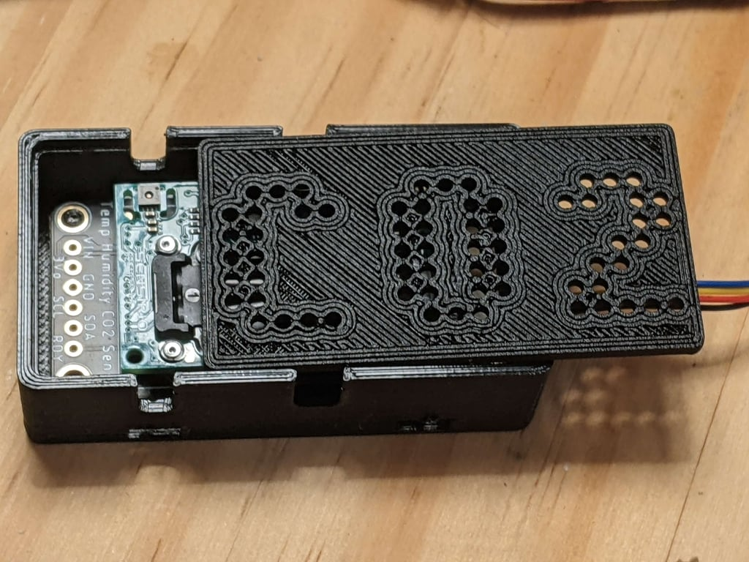
Portable co2 monitor
This project can be more complicated depending on how you want to do it, if you want to follow exactly what I did, it's pretty straightforward. But you can change it up
I used Adafruit hardware, it's easy to get, they are reputable, they have good resources, many schools already have them listed as an approved vendor
A C02 monitor of good quality is unfortunately not cheap, it's $60 by itself.

Slide 14
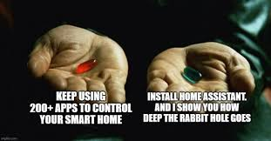
Home assistant
Home assistant can be a great way to tie your projects together
When you are in control of your projects, your data, and where your information is being sent, you can make sure it's only going places you want
Not everything can be tied into Home Assistant
Just because it's tied into Home Assistant doesn't mean it's secure and safe
Having a centralized location for your IoT devices to connect on your home network gives you the freedom to use your devices how you want, and also make sure they are not sending data anywhere.
You can even make Home Assistant not connect to the outside internet, just a local Wi-Fi or local network with no outside internet access to make sure your devices are as secure as they can be

Slide 15

Logitech media server (lms)
Having your own music service at home can mean you can play your music more easily without a subscription
You need digital copies of your music, there are also radio stations and potential ways to hook up to subscription services, but this works best with your own music on your own server
Biggest difficulty is getting speakers hooked up
Phones, tablets and computers connect easily
Wi-Fi speakers are expensive if you don't already have them, so you may still have to stream music over Bluetooth
I am not an audiophile, there may be quality issues with streaming, I have never on purpose bought a vinyl for "the sound quality man" so....Caveat Emptor.

Slide 16

How to figure out if you can secure your devices
If your device has a required app, it's harder to secure because most of the time those apps take your data and send it to the device creator/company
If your device has a required website login to use (some cameras have this), they may be unable to be fixed. They could be locked down too far by the company to prevent you keeping your own data
If the instructions for the device include anything about bypassing security restrictions on your router or firewall, "special setup" requires bypassing any of those things, internet access to the world at large, or data to be sent to the company, JUST SAY NO
If your device has the option for an app, but also has a setup that you can do without it, it's usually easier to lock it down
You can always lock the device away from the internet in general by preventing the IP address from accessing the internet at large

Slide 17

Want to learn more? Questions?
My website:
https://www.aholdengouveia.name/SmartHome/smarthomewelcome.html
My OER materials:
https://www.aholdengouveia.name/classes.html
https://oercommons.org/browse?f.author=Adrianna+Holden-Gouveia

